Slide 1
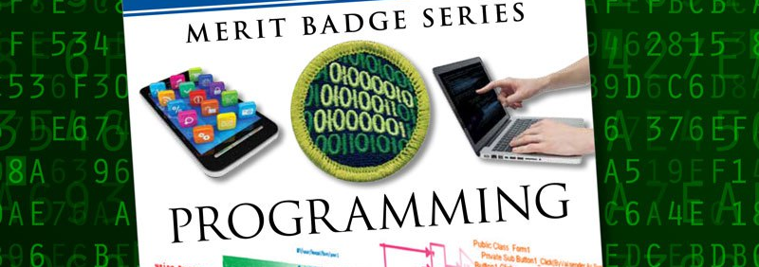
Programming
Clear Water Council
Merit Badge Clinic January 2017

Slide 2
“There are only 10 kinds of people in the world: those who understand binary and those who don’t.”
~ anonymous

Slide 3
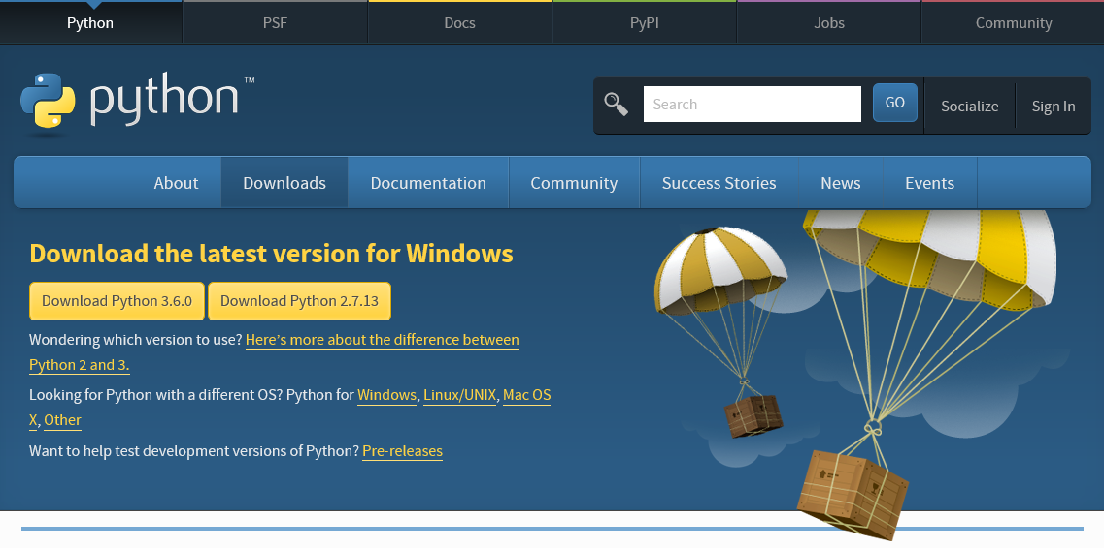
Download an Interpreter - Python
This is the program that reads Python programs and carries out their instructions; you need it before you can do any Python programming.
Go To https://www.python.org/downloads/

Slide 4
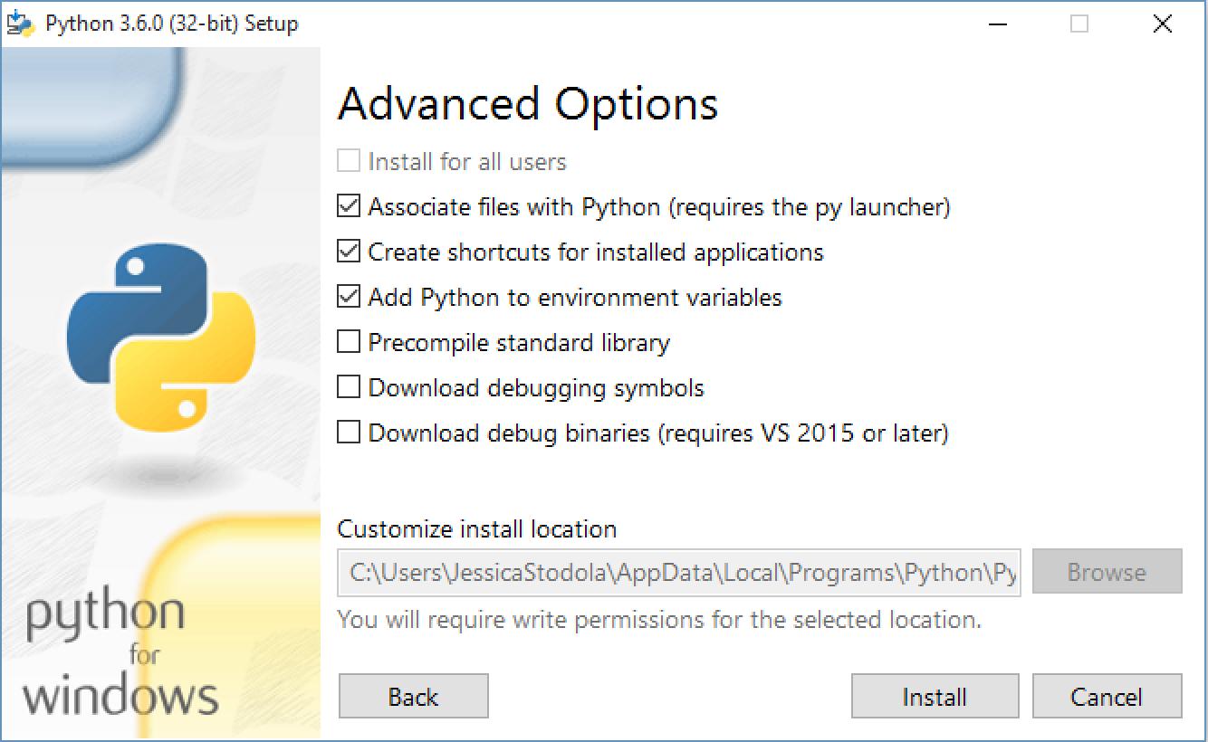
Python Installer

Slide 5
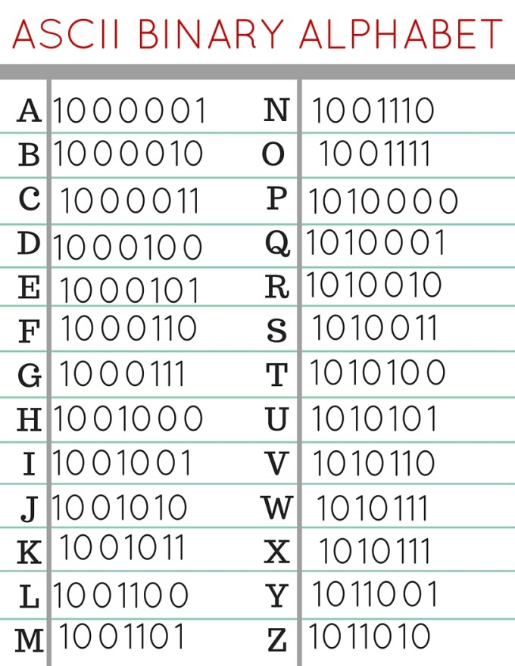

Hidden Message…
Notes:
Binary ASCII CODE

Slide 6
What is a Program?
Set of instructions
Tells a processor how to do a particular task

Slide 7
What is Programming?
Converting ideas into instructions
Understand the purpose of the program [Requirements]
Break instructions down into steps [Design]
Translate design into language [Coding]
Verify actual results match expected results [Testing]

Slide 8
Fun Facts
There are currently over 1.2 million programmers and software developers in the United States
More than 2,500 programming languages have been developed

Slide 9
History of Programming Languages
Jacquard Loom
Punch Cards

Slide 10
Ada Lovelace
1843
Ada Lovelace, a gifted mathematician, created the first computer programming language that wrote an algorithm for the Analytical Engine
(early mechanical computer)

Slide 11
Part of the Analytical Engine

Slide 12
John von Neumann
Conditional Control Transfer
If <condition> then <action a> else <action b>
if <raining> then <stay inside> else <go outside>
While <condition> do <action>
while <raining> do <hold umbrella>
subroutines, libraries, reusable code (functions & methods)
go outside:
stand up
walk to the door
open the door
walk out the door
close the door
Programming Pioneer
1903-1957
Notes:
Early innovator in game development

Slide 13
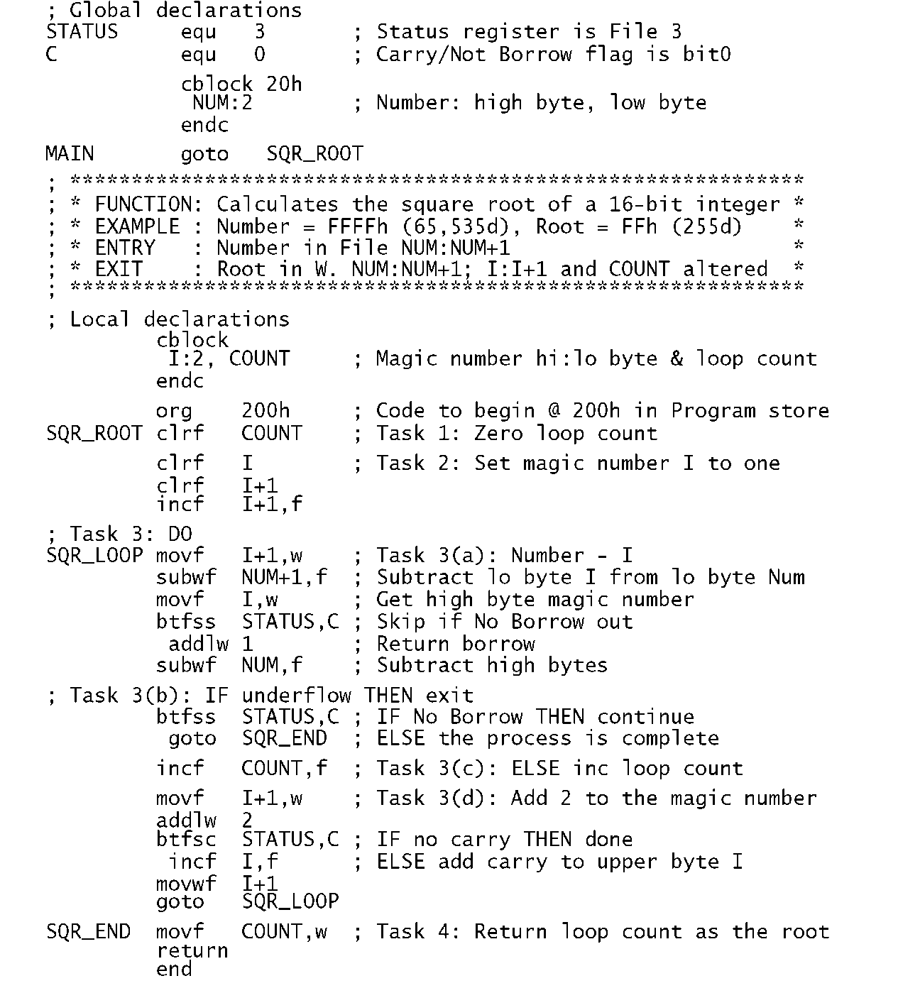
Assembly Language
Assembly language is hardware specific and is compiled into machine language (binary code)

Slide 14
High-Level Language
An advanced programming language
Easier for humans to understand
Not limited to single processor / machine

Slide 15
Early Important Languages
1950s
FORTRAN (1957)
John Backus (IBM)
Formula Translating System
High performance computing – weather and climate modeling
Computationally intensive
LISP (1958)
John McCarthy (MIT)
Recursion and list-processing
Artificial intelligence
COBOL (1959)
Common Business Oriented Language
Primarily used in business, finance, and admin systems
1960s-1970s
BASIC (1964)
John Kemeny and Thomas Kurtz (Dartmouth)
Beginner’s All-purpose Symbolic Instruction Code
Based on FORTRAN II
Pascal (1970)
Niklaus Wirth
Developed to encourage good programming practices
Structured programming
Data Structuring
C (1972)
Dennis Ritchie (AT&T Bell Labs)
Developed to implement Unix OS
One of the most widely used programming languages

Slide 16
Object-Oriented Programming
Different than procedural programming
Logical grouping / modularization of commands
Allows for re-use
Simula (1960s)
Smalltalk (1970s)
C++ (1983)
Java (1995)

Slide 17

The InterWebNets
World Wide Web + Internet
The Internet is a massive network of networks.
The World Wide Web (WWW) is a way of accessing information over the medium of internet.
https://assets.entrepreneur.com/content/16x9/822/20150828180844-internet-satellite-data-space.jpeg

Slide 18

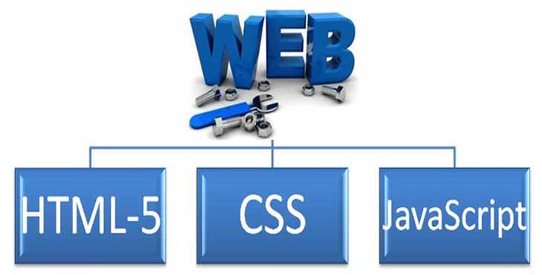
The World Wide Web
HTTP - Hypertext Transfer Protocol
New languages and markup
http://www.makemoneyonlinetrue.com/wp-content/uploads/2016/12/147949-3gWzaQ1381056341.jpg

Slide 19
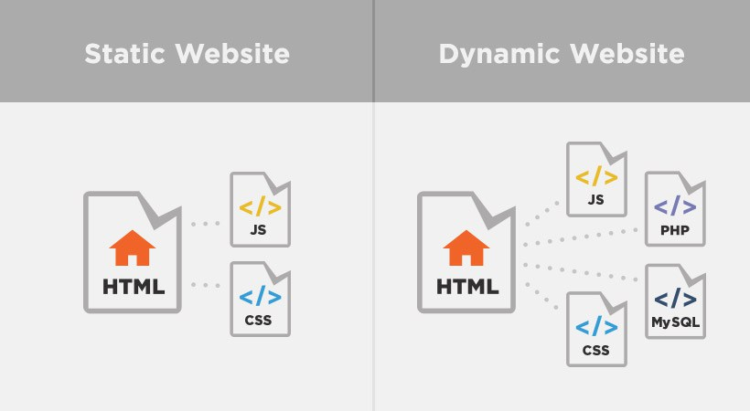
Static vs. Dynamic
http://i2.wp.com/blog.digitaltutors.com/wp-content/uploads/2014/08/featured023.jpg?w=820

Slide 20
Other Programming Languages
ADA (1980)
US Department of Defense and UK Ministry of Defence
Wanted standardized language
Objective-C (1983)
Apple programming OSX and iOS
PERL (1987)
Python (1991)
Official language of Raspberry Pi
Ruby (1993)
Web application development
Java (1995)
Android development
PHP (1995)
WordPress, Drupal
>81% of all websites
JavaScript (1995)
Dynamic web pages
C# (2000)
Dynamic web pages
Elixir (2012)
Dynamic web pages

Slide 22
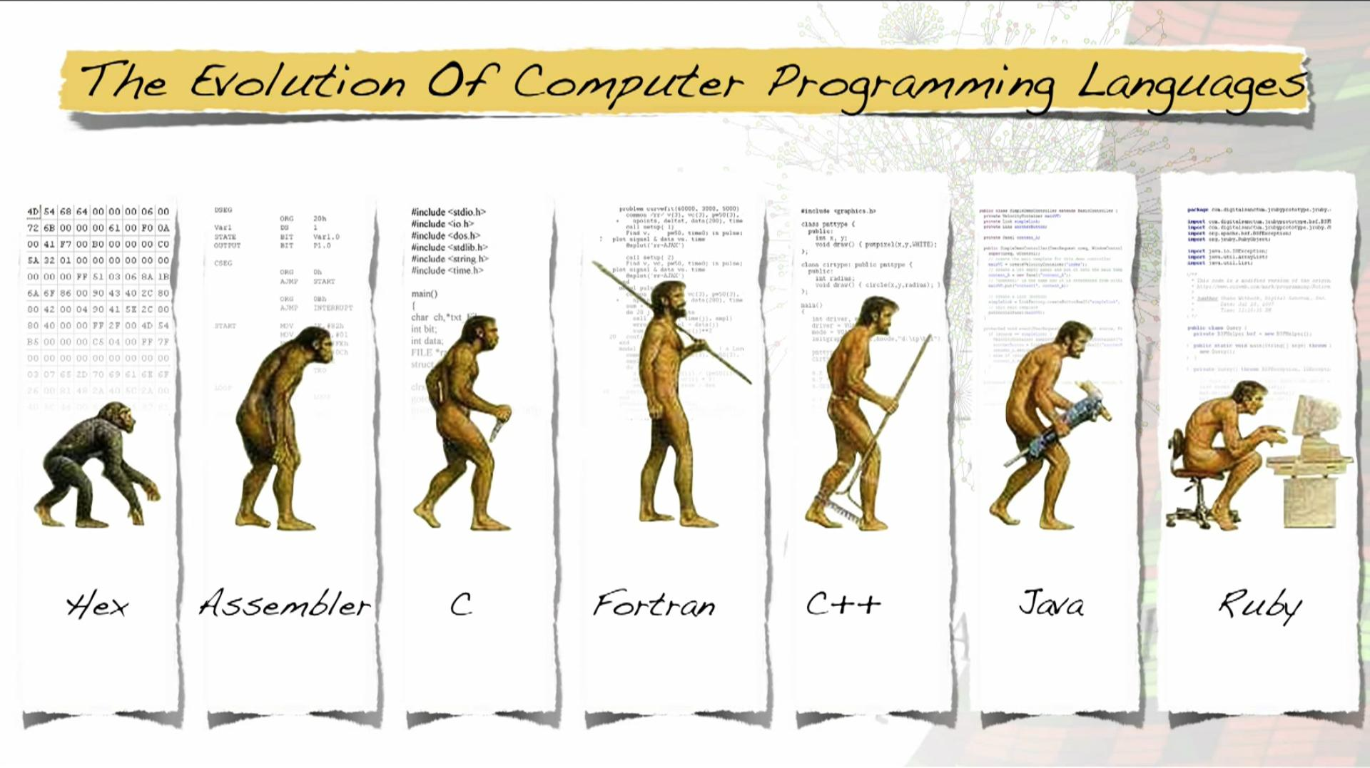

Slide 23

http://cms.ipressroom.com.s3.amazonaws.com/173/files/20147/53e26cc26eafb5045a000080_Intellectual+property/Intellectual+property_mid.jpg

Slide 24
Copyrights
Protects a particular expression of an idea
Automatically available once idea is created and physically stored
Protects against others making copies of images, code, etc.

Slide 25

https://media.licdn.com/mpr/mpr/shrinknp_800_800/AAEAAQAAAAAAAAZ2AAAAJGM4MGIxYTM5LWVlMjYtNDYyMS1hZWUyLTk2MTAyZTA0ZmE1NA.png

Slide 26
Patents
Protects useful and innovative:
Processes or methods
Machines
Manufactured items
Not automatic. Must be applied for with the US Patent and Trademark office
Lengthy process; often requires services of a patent attorney or agent

Slide 27

Trade Secrets
Protects commercially valuable information
Owner has taken strong measures to maintain secrecy
Does not protect against the use if developed independently or if information was acquired legitimately
http://teganblackburn.com/wp-content/uploads/2016/10/trade-secrets-pic.png

Slide 28

Understanding the Differences
OPEN SOURCE
Source code:
Available to public
Modifiable
May be redistributed
Community of developers
Free
Support can be community based or paid
Open Source Initiative (opensource.org)
FREEWARE
Free
Developer chooses free distribution
Source code not available
Distribution from developer site only
SHAREWARE
Free for limited/trial period
Developer owns rights
Source code not available
No collaborative community
Payment often required

Slide 29
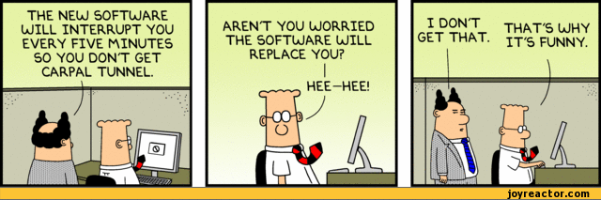
Safety
Repetitive Stress Injury (RSI)
Eyestrain
http://img1.joyreactor.com/pics/post/comics-dilbert-boss-dumb-574781.gif

Slide 30
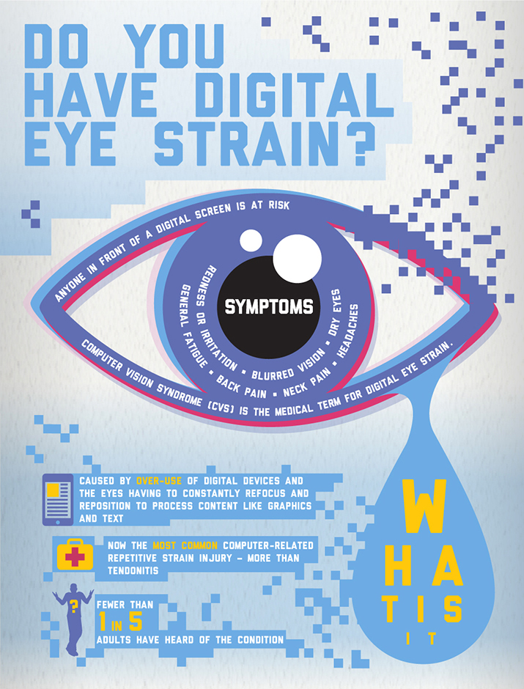
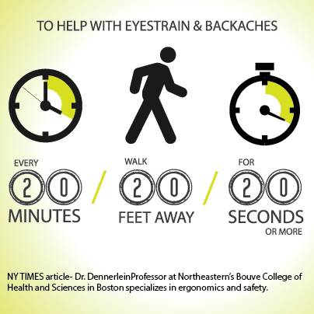
http://www.visionoptique.com/wp-content/uploads/sites/530/2015/12/vision-council-digital-eye-strain1.jpg
https://s-media-cache-ak0.pinimg.com/originals/c4/0d/ef/c40def66ef2156bacf90c7ad53ee069a.jpg

Slide 33

Take a Break
Eye breaks
Typing breaks
Rest breaks
Exercise breaks
http://www.mirci.org/wp-content/uploads/50-ways-to-take-a-break.jpg

Slide 34
Where is Programming Used?

Slide 35

Programmed Devices
Mobile Phones
Tablets
DVD / Blu-ray
Game Consoles
Alarm Clock
TV / DVR
Cars
Watch
Fitness Trackers
GPS
Coffee Pot
Microwave

Slide 36
Business Applications
Retail
Point-of-sale systems
Receipt printers
Card readers
Cash drawers
Warehouses
Inventory control
Temperature control
Accounting
Accounting systems to track money
May be integrated with point-of-sale and inventory systems
Administrative
Communication systems
Word processing
Spreadsheet applications

Slide 37
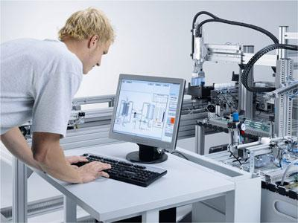
Factory Automation
Programmable Logic Controller (PLC)
Designed specifically to control machines
Machines themselves are not programmed
Can be programmed to do the same task over and over again
Durable
Work in wide temperature ranges
Work in harsh conditions
http://www.leventparali.com.tr/files/page/4d4518f294.jpg

Slide 38

History of PLCs
Factories were controlled by relays; on or off
Lights
Conveyor Belts
Fans
Ovens
Hundreds and thousands may be used
Cabinets full of relays and wires
Bulky and hard to fix
Changing process was hard; required re-wiring
Modular Digital Controller (MODICON; late 1960s)
Simple computer; replaced relays

Slide 39
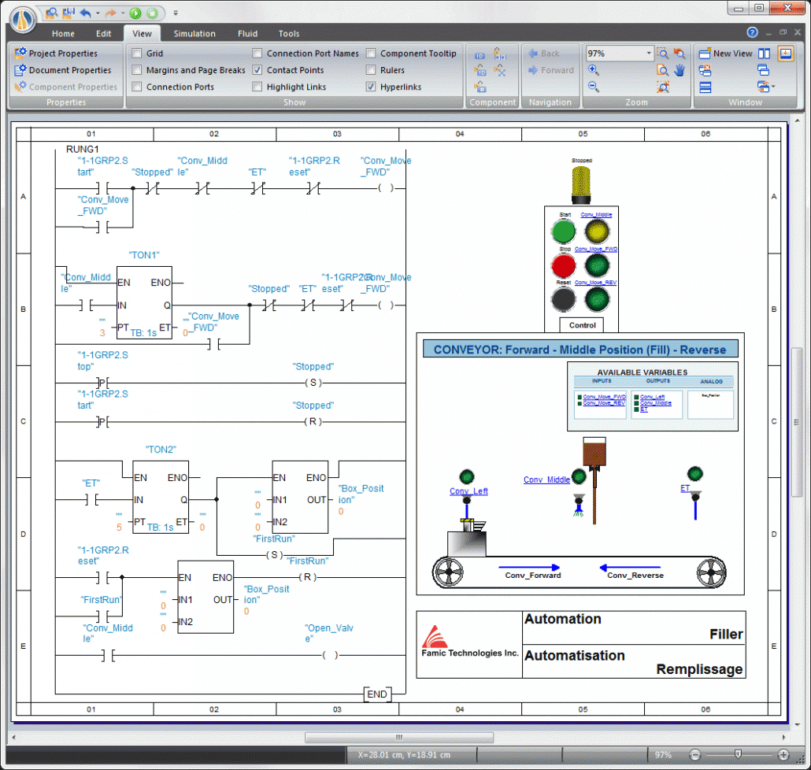
Programming PLCs
Different than other kinds of programming
Several ways to be programmed
Ladder Logic – most popular
Resembles a relay wiring diagram
True = 1 = input energized.
False = 0 = input NOT energized.
http://www.clxengineering.com/wp-content/uploads/2014/10/PLC-Ladder-Logic-Change-Name-1030x978.gif

Slide 40
Where else can we use Programming?

Slide 41


Slide 42
Programming for the Internet

Slide 43
Web Applications

Slide 44
Databases

Slide 45
Structured Query Language (SQL)
Data Definition Language (DDL)
Definition of database structure
Data access control
Data Manipulation Language (DML)
Query language to create, read, update, and delete (CRUD)
SELECT
INSERT
UPDATE
DELETE

Slide 46
Version Control Systems

Slide 49

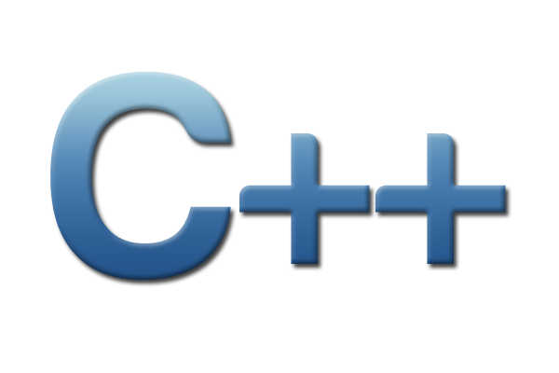

Three Programs

Slide 50
Programming Resources
Code Academy: www.codecademy.com
Code.org: www.code.org
Learn Python: www.learnpython.org
Learn C++: www.learncpp.com
Scratch: scratch.mit.edu
Killer PHP: www.killerphp.com
W3 Schools: www.w3schools.com
Tutorials Point: https://www.tutorialspoint.com/

Slide 51
Contact Info
Jessica Stodola
jtstodola@gmail.com
jess@jstodola.com
Twitter: JessicaTStodola
Github: jtstodola

